Slide 1

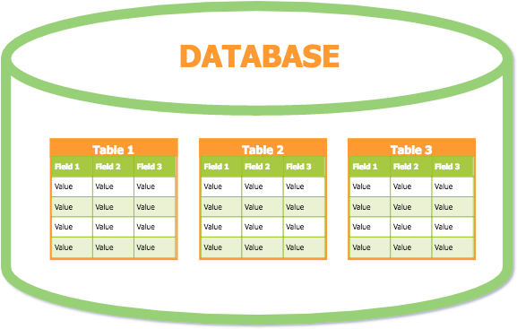
Lesson 9 Relational Mapping
1

Slide 2
Relational Data Model
A relational database is a collection of data items organized as a set of formally-described tables from which data can be accessed or reassembled in many different ways without having to reorganize the database tables.
The relational database was invented by E. F. Codd at IBM in 1970.
Relational Data Model represents the DB as a collection of relations which contains multiple tuples and each value in a tuple must be an atomic value.

Slide 3
Key Attributes
They are used to establish and identify relation between tables.
They also ensure that each record within a table can be uniquely identified by combination of one or more fields within a table.
Super Key
Candidate Key
Primary Key
Foreign Key

Slide 4
Super Key
Any combination of attributes within a relation that uniquely identifies each tuple within that relation.
The set of all the attributes of a relation is always a super key.
Eg: Student {StudentID, Name, NIC, CourseID}

Slide 5
Key Attributes
Super Key
Eg: Student {StudentID, Name, NIC, CourseID} Super Keys:
{StudentID}
{StudentID, Name}
{StudentID, NIC}
{StudentID, Name, NIC}
{StudentID, CourseID}
{StudentID, Name, CourseID}
{StudentID, Name, NIC, CourseID}

Slide 6
Candidate Key
An irreducible (cannot separate) set of attributes which uniquely identifies a tuple in a relation.
Even if one or more attributes are excluded, the remaining attributes still uniquely identifies a tuple.
A single field or the least combination of fields that uniquely identifies each record in the table.
A subset of a super key.
Every table must have at least one candidate key.

Slide 7
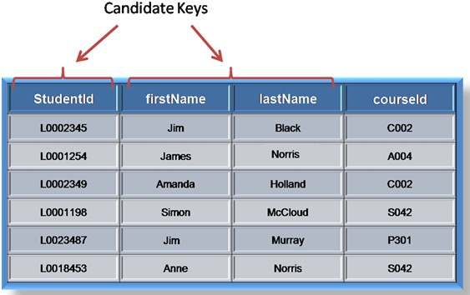
Candidate Key

Slide 8
Candidate Key
All candidate keys are super keys. But not all super keys are candidate keys.
Candidate keys are specified with the UNIQUE constraint.
A super key may be reducible.
{StudentID} ???
A Super Key and a Candidate Key
{StudentID, FirstName}
{StudentID, CourseID}
{FirstName, LastName}
Super Keys but not Candidate Keys

Slide 9
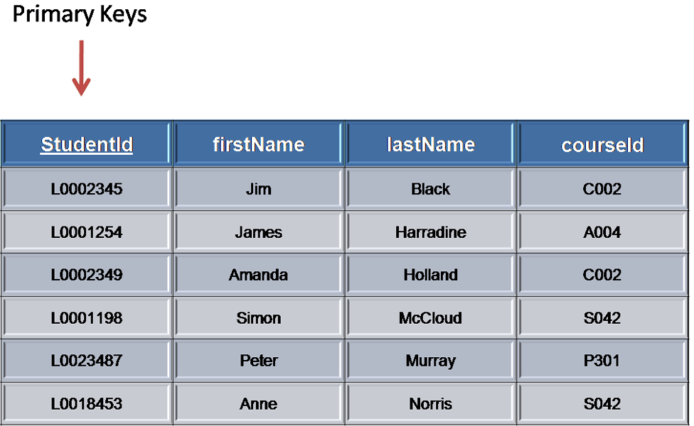
Primary Key
A candidate key chosen to be the main key for the relation.
Should select the candidate key with minimum combination of attributes.
Only one for each relation.

Slide 10
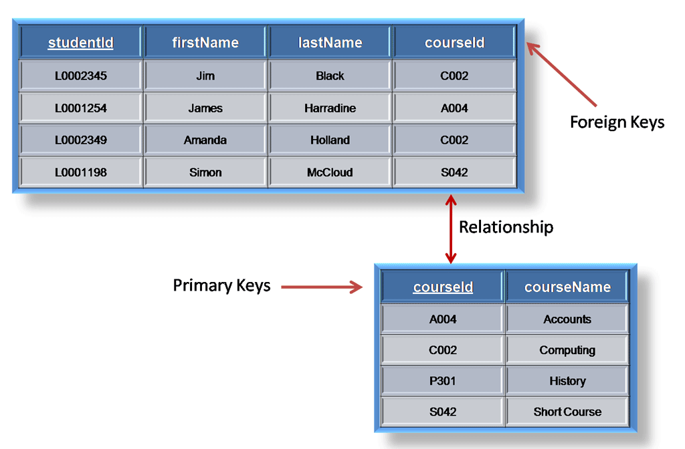
Foreign Key
A field in a relation which links another relation.

Slide 11
Relational Model Constraints
Domain Constraints
Specify that the value of each attribute must be atomic.
A pool of allowable values from which actual attribute values
are drawn.
Can be achieved using:
built-in data types (eg: DATE, NUMBER)
user-defined data types
restriction on range of allowable values
required value
unique value

Slide 12
Relational Model Constraints
Key Constraints
– No two tuples can have the same combination of values for all their attributes.
Entity Integrity Constraints
– No primary key value can be null. It is unique. Every table MUST have a primary key.

Slide 13
Relational Model Constraints
Referential Integrity Constraints
A tuple in one relation that refers to another relation must refer to an existing tuple in that relation.
Ensures that where a foreign key exists in a table, the foreign key value must either match a candidate key (usually the primary key) of a row in the home table or be completely null.

Slide 14
Convert of ER Model to Relational Schema
14

Slide 15
Mapping of Regular Entity Types
Create a relation for each regular (strong) entity type in the ER
diagram.
Include all the simple attributes of the entity.
Underline the chosen key attribute as the primary key.
Any composite attributes must be represented as simple attributes.
Omit multi valued and derived attributes.

Slide 16
Mapping of Weak Entity Types
Create a new relation for each weak entity.
Include all the attributes of the weak entity.
Add the primary key of the strong entity (owner entity) as a foreign key.
The primary of the weak entity will be a combination of the foreign key (primary key of owner entity) and the partial key of the weak entity (Composite PK).

Slide 17
Mapping of Binary 1:1 Relation Types
For 1:1 relationships, select any side of the relation (better to choose an entity type with a total participation).
Indicate the primary key of the other relation as the foreign key on the selected relation.
Include all the simple attributes of the 1:1 relationship type as the attributes of the chosen entity type.

Slide 18
Mapping of Binary 1:N Relationship Types
For a 1:M relationship, select the MANY side of the relation.
Include the primary key of the ONE side relation as the foreign key in the selected relation.
Include any simple attributes of the 1:M relation type as attributes of the selected relation.

Slide 19
Mapping of Binary M:N Relationship Types
For a M:N relationship type, create a new relation.
Include the primary keys of both relations as foreign keys in the new relation.
The combination of both foreign keys will form the primary key of the new relation (Composite PK).
Include any simple attributes of the M:N relationship type.

Slide 20
Mapping of Multivalued attributes
For each multivalued attribute, create a new relation.
Include the primary key as a foreign key of the new relation multi valued attribute.
The primary key of the new relation is the combination of the foreign key and the multi valued attribute (Composite PK).
If the multivalued attribute is composite, include its simple attributes.

Slide 21
Mapping of N-ary Relationship Types
For each n-ary relationship (where n>2), create a new relation.
Include the primary keys of the relations that represent the participating entity types as foreign keys.
Include any simple attributes of the n-ary relationship type.
The combination of all foreign keys will form the primary key of the new relation (Composite PK).

Slide 22
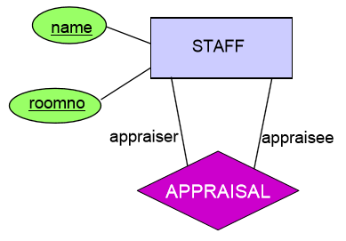
Mapping Recursive Relationships
Add the primary key to the same relation again.

Slide 23
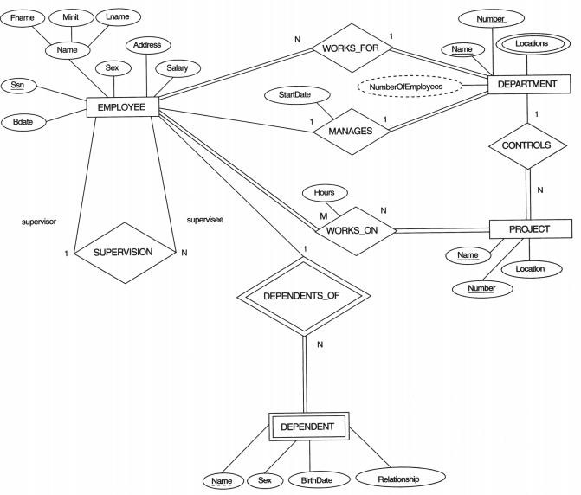

Slide 24
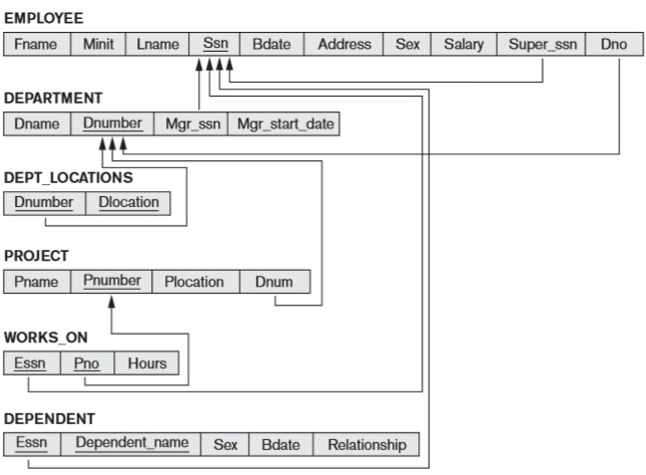

Slide 25
Mapping Specialization/Generalization
Mapping of EER to Relational Model
Uses four options:
Option A: Multiple relations with superclass and subclasses
Option B: Multiple relations with subclass relations only
Option C: Single relation with one type attribute
Option D: Single relation with multiple type attributes

Slide 26
Sub classes : S1, S2, S3 . . . . . . Sm
Super class : C
Attributes of C are : {K, a1, a2, a3, . . . . , an } K – PK of the super class

Slide 27
Option A
Multiple relations with superclass and subclasses.
Works for any specialization (total or partial, disjoint or overlapping).

Slide 28
Option A
Create a relation L for C with attributes
Attrs(L) = {K, a1, ..., an} and PK(L) = K
Create a relation Li for each subclass Si, 1 ≤i≤m, with the attributes
Attrs(Li) = {K} 𝖴 {attributes of Si} and PK(Li) = K

Slide 29
Option B
Multiple relations with subclass relations only.
Works only for a specialization whose subclasses are total and disjoint
If the specialization is overlapping, the same entity may be duplicated in several relations.

Slide 30
Option B
Create a relation Li for each subclass Si, 1 ≤ i ≤ m, with the attributes
Attrs(Li) = {attributes of Si} 𝖴 {K,a1,...,an} and PK(Li) = K

Slide 31
Option C
Single relation with one type attribute.
Works only for a specialization whose subclasses are disjoint, and has the potential for generating many NULL values if many specific attributes exist in the subclasses.

Slide 32
Option C
Create a single relation L with attributes
Attrs(L) = {K,a1,...,an} 𝖴 {attributes of S1} 𝖴...𝖴 {attributes of Sm} 𝖴 {t} and PK(L) = K
The attribute t is called a type (or discriminating) attribute whose value indicates the subclass to which each tuple belongs, if any.

Slide 33
Option D
Single relation with multiple type attributes.
Used for a specialization whose subclasses are overlapping (but will also work for a disjoint specialization).

Slide 34
Option D
Create a single relation schema L with attributes
Attrs(L) = {K,a1,...,an} 𝖴 {attributes of S1} 𝖴 ...𝖴 {attributes of Sm} 𝖴 {t1,t2,...,tm} and PK(L) = K
Each ti,1 ≤ i ≤ m, is a Boolean type attribute (0 or 1)
indicating whether a tuple belongs to subclass Si.

Slide 35
Mapping of Specialization Lattice
(Multiple Inheritance)
All subclasses must all have the same key attribute; otherwise, the shared subclass would be modeled as a category (union type).
Apply any of the options discussed in step 8 to a shared subclass, subject to the restrictions discussed in step 8 of the mapping algorithm.
A shared subclass inherits all the attributes of its super classes.

Slide 36
Mapping of Union Types (Categories)
For mapping a category whose defining super classes have different keys, it is customary to specify a new key attribute, called a surrogate key, when creating a relation to correspond to the category.
The keys of the defining classes are different, so cannot use any one of them exclusively to identify all entities in the category.
Create a relation correspond to the category and include any attributes of the category in to this relation.

Slide 37
Mapping of Union Types (Categories )
The primary key of the new relation is the surrogate key.
Also include the surrogate key attribute as a foreign key in each relation corresponding to a superclass of the category, to specify the correspondence in values between the surrogate key and the key of each super class.
If a particular super class entity is not a member of the category, it would have a NULL value for its surrogate key in its corresponding tuple in the super class relation, and it would not have a tuple in the category relation.

Slide 38
Mapping of Union Types (Categories )
It is also recommended to add a type attribute to the category relation to indicate the particular entity type to which each tuple belongs.
For a category whose super classes have the same key, there is no need for a surrogate key.

Slide 39
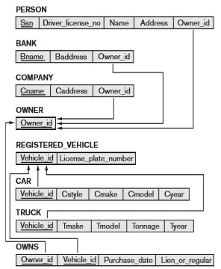
Example

Slide 40
Thank You
40

